Slide 1
PinkBox
By: Aarithi Rajendren, Lara Afont, Erriana Thomas, Isabelle Carminati
An Application for Movie Lovers

Slide 2
Overview
1
2
3
Introductions
Our Problem & Solution
Languages & Frameworks
4
5
6
System Architecture
Risk Management
Next steps
Group Members and their role on the team
Our project idea and proposed solutions
Technology and tools used for our project
Our system’s structure and components
Risks, probability, effects, mitigation
Issues we want to tackle next

Slide 3
01.
Introductions

Slide 4
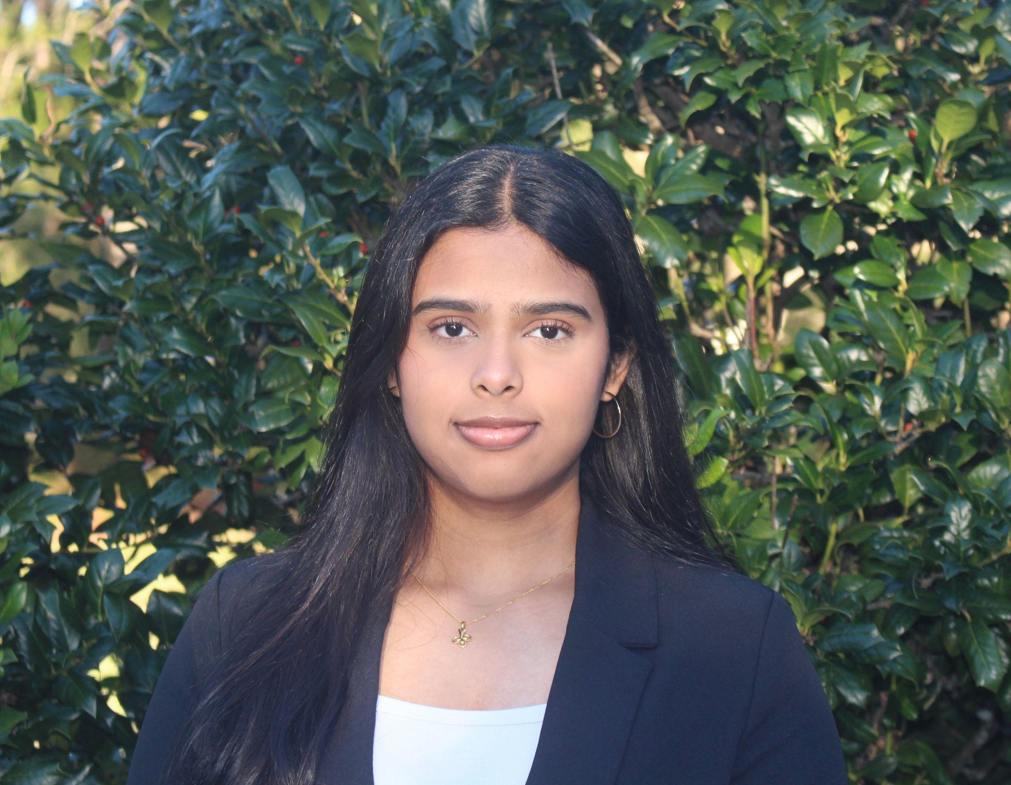
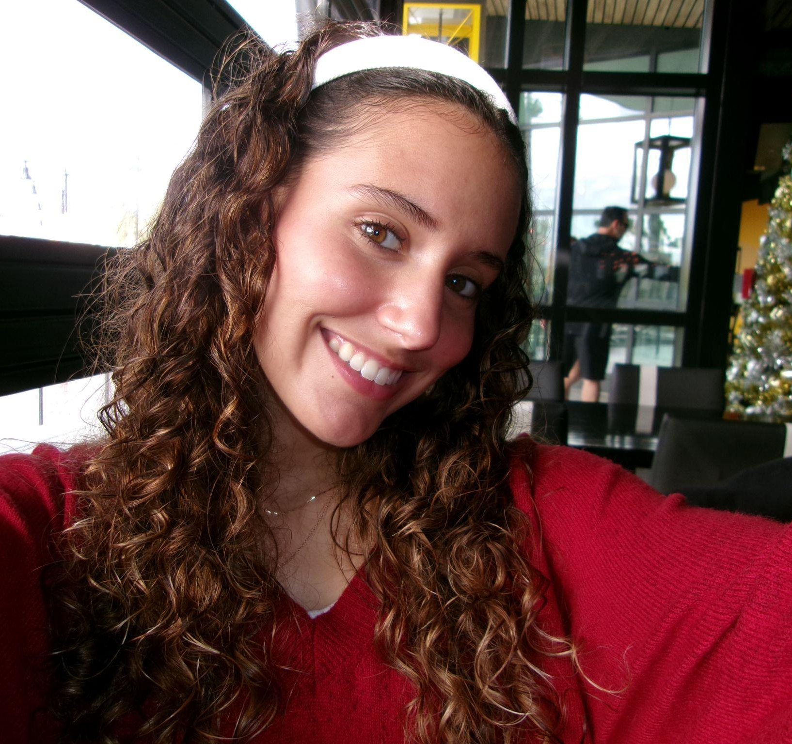

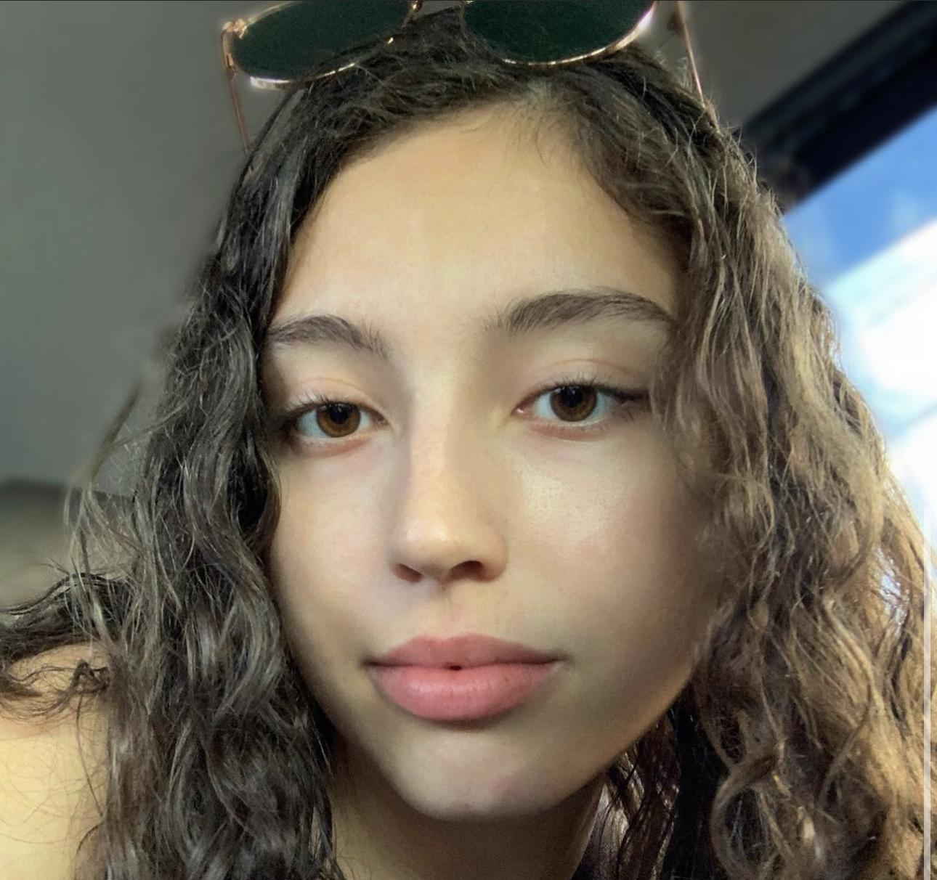
Our Team
Aarithi Rajendren
Lara Afont
Erriana Thomas
Isabelle Carminati
Back-end Developer
Back-end Developer
Front-end Developer
Front-end Developer

Slide 5
02.
Project Idea
Problem & Proposed Solution
Notes:
Lara will introduce this section

Slide 6
PinkBox
Problem Statement
There is no one-stop for movie lovers to purchase their favorite movies. One too many subscriptions are required to have access to all of your favorite movies.
Our Solution
Through PinkBox, sellers we will gain access to movies by partnering with movie production companies and the buyers will have the opportunity to purchase the movie directly from us for a better price and will receive a link that will directly take them to a website where the production company of the movie has stored the film.
Notes:
Lara: At the moment, there is no one-stop platform for movie lovers to purchase their favorite movies. I’m sure we can all relate to having one too many subscriptions for one too many different streaming platforms, whether it be Netflix, Amazon, Hulu, and it is hard to keep up with so many different websites. That’s where our website, PinkBox, comes in. PinkBox is an e-commerce website that allows customers to have a convenient platform where they can find any type of movie that they would like to watch and have the option to buy it. As sellers, we will gain access to movies by partnering with movie production companies and the buyers will have the opportunity to purchase the movie directly from us for a better price and will receive a link through their email to an mp4 file in which they can download to watch their favorite movie.

Slide 7
03.
Languages & Frameworks
Notes:
Now I will be talking about some of the languages and frameworks we will be utilizing in our product.

Slide 8
Technology/Project Languages/Framework
MERN Stack
Front-End
Back-End
Database Management
React JS
HTML/CSS, JavaScript, BootStrap
Express Web Framework
MongoDB
Mongoose
Node JS web server
Notes:
We will be using the MERN technology stack for our web application. The frontend development will be managed by React JS, which involves HTML, CSS, Javascript, and Bootstrap (which is an open-source CSS framework directed at responsive web development). Backend development will be comprised of Express JS and Mongoose, both of which interact with the Node JS web server. Finally, database management will be done using MongoDB.

Slide 9
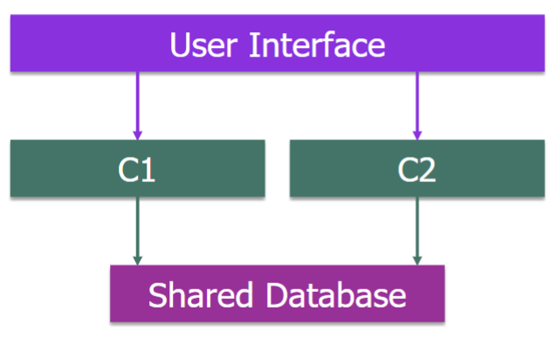
Shared Database
Cloud Database: MongoDB Atlas will be deployed to Google Cloud thus it is considered a cloud database.
Offers high flexibility and scalability
Store user data, movies, and orders
JSON document => key-value pair
User authentication is performed by exchanging JWT between frontend and backend to ensure authenticated user are allowed to perform certain activities.
Notes:
MongoDB Atlas will be deployed to Google Cloud, thus it is considered a cloud database. Any changes made to the database or the data are a one-time task and are immediately available to all team members. Additionally, this type of database offers high flexibility and scalability. The database will be used to store user data, movies, and orders. There will be two collections, the first one will store user profiles and the second one will store all the information related to a movie. MongoDB expects information to be stored as a JSON document, which is basically a key-value pair. User authentication will be performed by exchanging a JSON web based token between frontend and backend to ensure only authenticated users are allowed to perform activities such as adding movies to the cart and checking out.

Slide 10
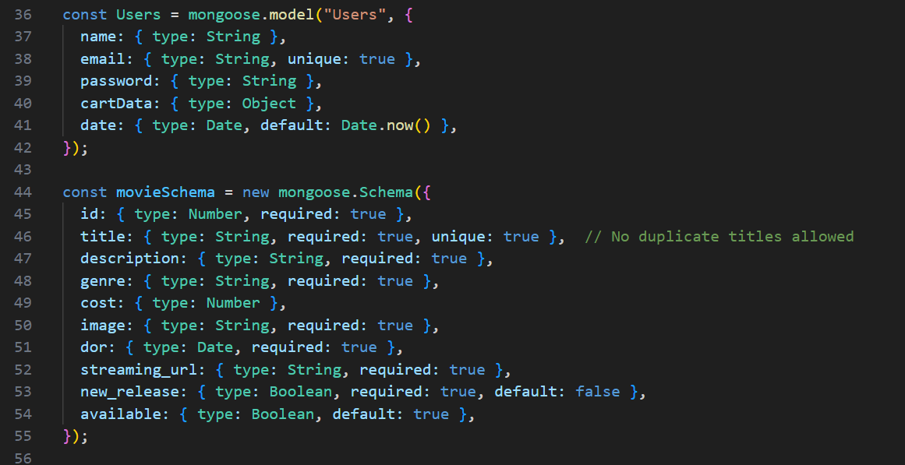
Tools
IDE: VS Code
MongoDB Compass
Miro
Notes:
The IDE in which we will be coding is VS code. We will also be using MongoDB Compass which is the graphical user interface for exploring, analyzing, and manipulating MongoDB data. Finally, we will be using Miro as our project management tool to distribute work and ensure we are all on the same page. On a side note, the screenshot of code on this slide is from VS code and shows how we have set up the user profile collection and the movie information collection mentioned on the previous slide.

Slide 11
04.
System Architecture
Notes:
Now, I will be talking about the system architecture.

Slide 12
System Architecture
Microservices Architecture
Client-Server Pattern
Layered Pattern
Allows each part of the system—such as user authentication, movie catalog management, etc.—to be developed and scaled independently; provides the flexibility to have multiple APIs
Clients send requests to a server to perform actions like fetching movie lists, handling user authentication, and managing shopping carts.
Within the MERN stack where the frontend is managed by React.js, the backend logic by Express.js and Node.js, and the database operations through MongoDB
Notes:
PinkBox will be having a microservices architecture since it would allow each part of the system, such as user authentication, movie catalog management, etc to be developed and scaled independently, This will also provide the flexibility to have multiple APIs. In terms of architecture pattern, Pinkbox will have a client-server pattern since clients will be sending requests to a backend server to perform actions like fetching movie lists, handling user authentication, and managing shopping carts. Additionally, it will also have a layered pattern within the MERN stack where the frontend is managed by React JS, the backend logic by Express JS and Node JS and database operations through MongoDB.

Slide 13
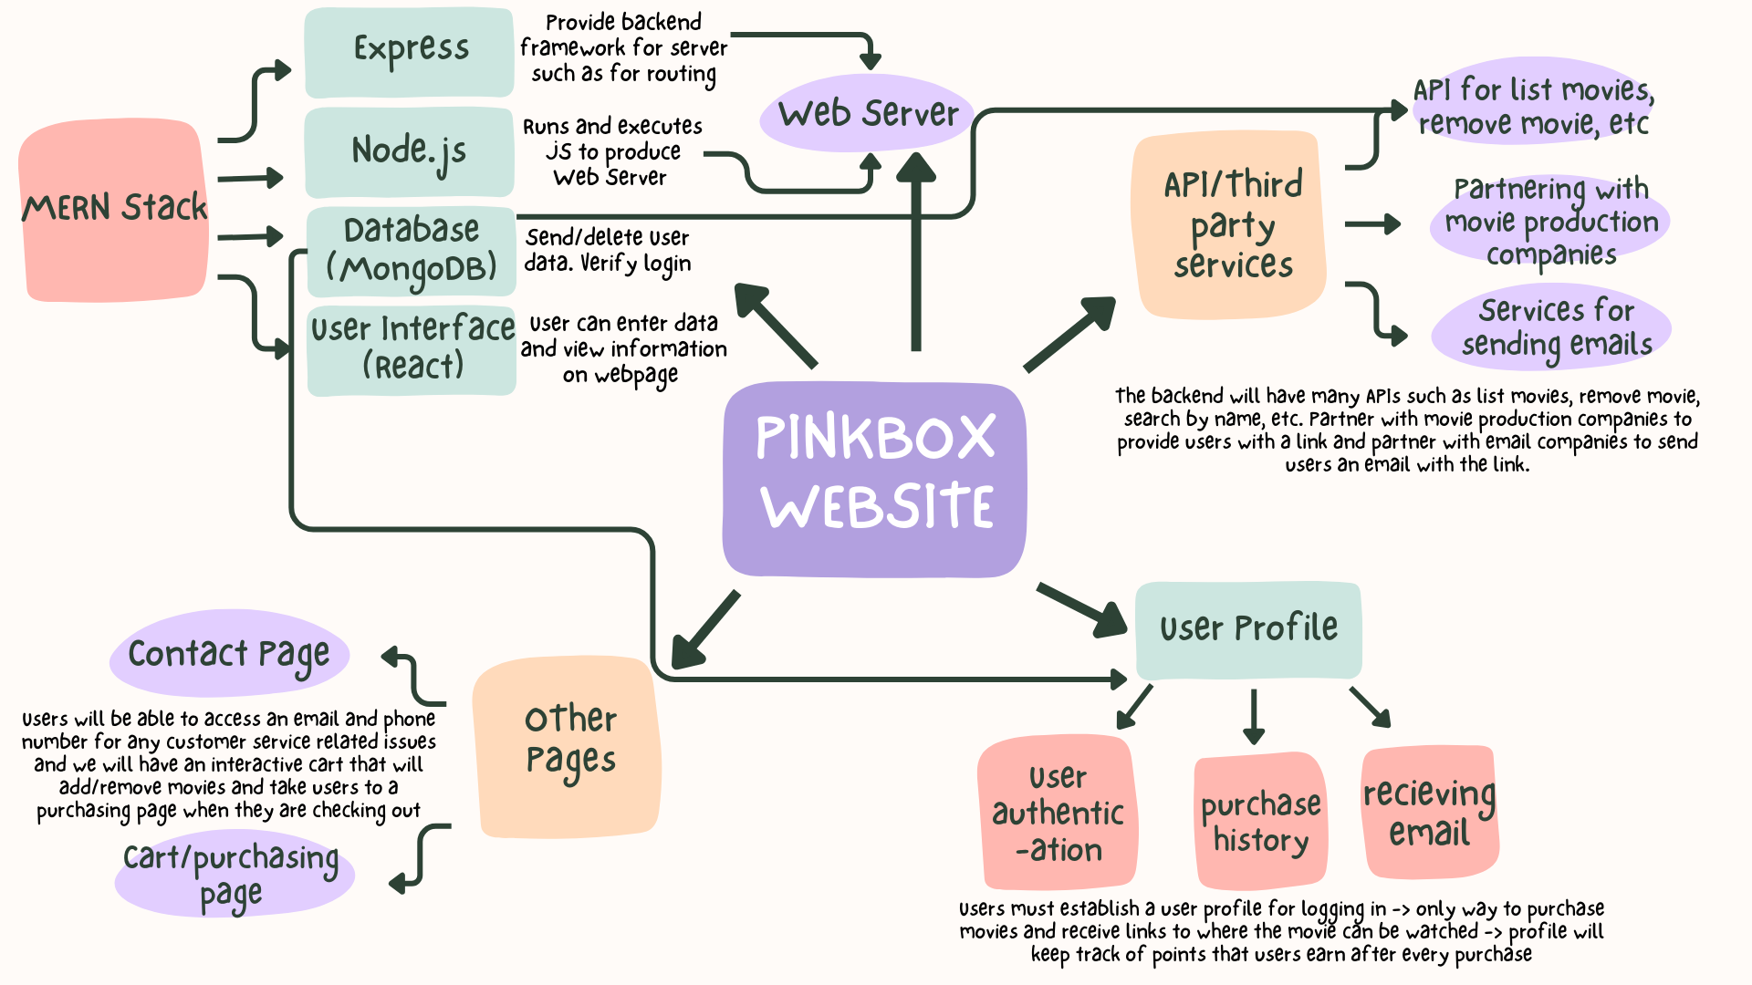
System Context Model
Notes:
On this slide, we have included our system context model. Pinbox will be web-based and will connect to a web server through Express JS and Node JS, which is a part of the MERN stack as mentioned earlier. We will have APIs such as list movie, remove movie, etc to serve as a connection between the backend and frontend. We will have some third party services such as the movie production companies to provide us with links to the movie and partnerships with email companies to send users an email with the link to watch the movie. The user profile will be used to perform user authentication, keep track of purchase history, and sending users an email with their purchase. Finally, we will also have a contact page with customer service related information and have a cart management and purchasing page so users know exactly what they will be purchasing.

Slide 14
05.
Risk Management
Risks & Mitigation

Slide 15
Risk Management
Risk | Probability | Effects | Mitigation
Incompatible Movie Format | Low | Insignificant | Inform users about supported formats, provide media player download links
Corrupted Movie Files | Low | Moderate | Require movie company to test files, offer re-download option
Copyright Infringement Issues | Low | Serious | Require users to accept terms & conditions, clearly outline copyright policies

Slide 16
06.
Next Steps
Notes:
Lara will introduce this section

Slide 17
Sprint 1 Backlog Plans
Issues | Roles
User Login Authentication | Lara, Aarithi, Isabelle, Erriana
Design Database of Movies | Lara, Aarithi
Establish APIs (list movie, remove movie) | Lara, Aarithi
Display Movie Information | Isabelle, Erriana
Notes:
Lara: For our Sprint 1 backlog plans, the next couple of issues we will be focusing include the user login authentication where users will be prompted to create an account with our website to use it. This will take both front end and back end to properly display the log in page on our website. Our backend developers will also focus on designing the database of movies within our website and establish APIs for functions like list movie and remove movie. Finally, our front end developers will work on displaying the movie information on the home page of our website, including the titles, genres, posters, and prices.

Slide 18
Velocity and Capacity
User Login
Database of Movies
Establish APIs
Display Movies
9 points, 8 hours
4 points, 2 hours
7 points, 8 hours
8 points, 8 hours
1st Issue
2nd Issue
3rd Issue
4th Issue
Velocity
Capacity
14 points/sprint
208
Total Work Needed
Total Work Possible
Notes:
Lara: After calculating the total work needed and total work possible from the values presented in this slide for each Sprint 1 issue, we decided that the velocity would be 14 points per sprint and the capacity would 208.

Slide 19
Issues & Next Steps
1.
2.
3.
4.
Building user interface
Connecting Back-end with Front-end
Testing
Deployment

Slide 20
User Stories- Updating Shopping Cart
How will the cart automatically update on its own?
Will the shopping cart continue calculating the current total price of all of my items?
What if I want to remove items from my shopping cart?
As a customer, I want my shopping cart to automatically update with the movie information and prices when I click “Add To Cart” so that I can seamlessly purchase the movies I want to buy.
The website will automatically track and store which movies are selected and this information will be displayed in a shopping cart window
The shopping cart will continue calculating the summed total of all of the movie prices that you have selected to return an accurate amount of how much you are expected to pay
To remove items from the shopping cart, there’ll be a discard button near the movie selection and will deduct this price from the total price of the entire shopping cart to make shopping easy and friendly

Slide 21
User Stories- Sufficient Product Information
How will I import the relevant data regarding a product?
What information about the product would the user feel necessary?
Will the user find the process of viewing the displayed information user-friendly?
As a customer, I want to have enough relevant information about the product to make an informed decision on whether the product fits my needs/wants and whether I want to purchase it.
All product information will be connected through an API from a movie website to ensure up to date information will be displayed
Important information will be narrowed down by focusing on what movie production companies believe to be the most relevant details about their product
Users will be able to easily navigate to find specific product information by having product information displayed under each product with each category in bold to be identifiable

Slide 22
User Stories -Purchased Follow Through
How will I get confirmation of my purchase?
What do I do if I do not get confirmation or my purchase?
Will I receive my product electronically or by mail?
As a customer, I want to get confirmation that I have purchased my product because I do not want any issues with a transaction. I also want to ensure that I actually receive it.
An email is sent to the registered email address of your purchase including the items bought
You may have not checked out your product. If you did, email the provided customer service for assistance
Electronically a playable .mp4 of your product(s) through your registered email address

Slide 23
User Stories -Copy Infringement Issues
How would I be appropriately compensated for the product I am selling?
What will PinkBox do to ensure users do not infringe on copyright policies?
Will users be penalized for violating the user guidelines?
As a seller (movie production company), I would want users to follow all copyright policies and that they treat users with respect.
Movie production companies will receive 40% of the selling price of the movie sold to users.
Users will sign a terms & conditions when creating their account and will be made aware of consequences from not adhering to these guidelines.
Users will be banned from our website and required to delete the mp4 file.

Slide 24
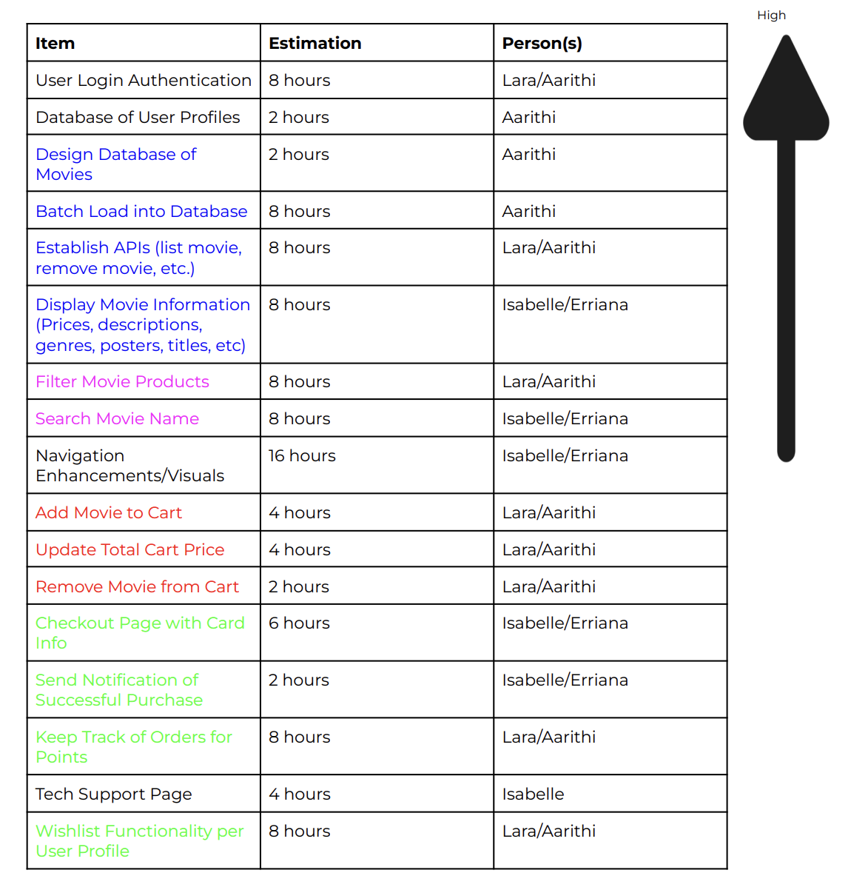
Backlog
User Stories: Update Shopping Cart
Sufficient Product Information
Follow-through with Purchased Product
Filter Products
Black - applies to all user stories

Slide 25
Thank You!

